Slide 1
XML-Basic knowledge
Name Referent
Title/ Function
Corporate Customer & Enterprise Integration
Date

Slide 2
XPath-Basic knowledge
What is Xpath
XPath-Expression
Axis-model
Functions
Examples

Slide 3
What is Xpath
Motivation & History
XPath, the XML Path Language, is a query language for selecting nodes from an XML document
1999 Xpath Version 1.0
XPath 2.0 became a Recommendation on 23 January 2007. changed XQuery and XPath Data Model
XPath 3.0 became a Recommendation on 8 April 2014
XPath is a syntax for defining parts of an XML document
XPath uses path expressions to navigate in XML documents
XPath contains a library of standard functions
XPath is a major element in XSLT
100 built-in functions. There are functions for string values, numeric values, date and time comparison, node and QName manipulation, sequence manipulation, Boolean values, and more.

Slide 4
XPath-Expression
An Expression has:
axis-test
node-test
Predicates (optional)
axis::node-test[predicate 1][predicate 2]...
Example: /descendant-or-self::Foo/child::*
Selects all elements which are children of node with the name „foo“
Same as:
.//Foo/*

Slide 5
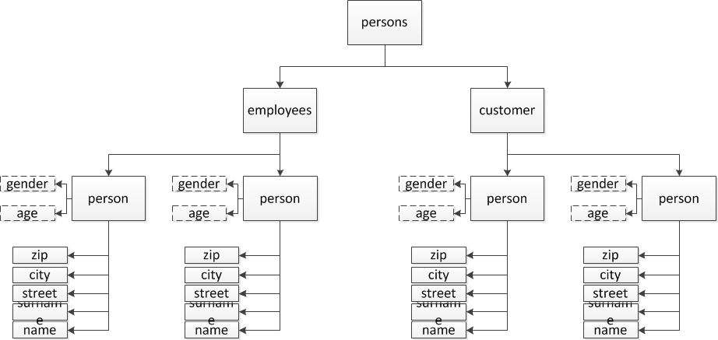
Axis-model

Slide 6
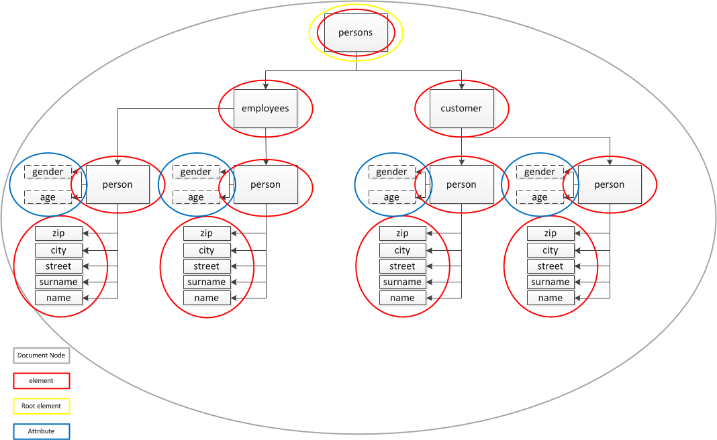
Axis-model

Slide 7
Axis-model
Achse | adressierte Knoten | Beispiel | Abkürzung
child | direct child nodes | /persons/employees/person[1]/child::* | *
parent | direct parent node | /persons/employees/person[1]/parent::* | ..
self | the node itselft | /persons/employees/person[1]/self::* | .
ancestor | All parent nodes up to the root | /persons/employees/person[1]/ancestor::*[1]
ancestor-or-self | Same as ancestor but the node itself too | /persons/employees/person[1]/ancestor-or-self::*[1]
descendant | All child nodes follwoing, not only the direct childs | /persons/employees/person[1]/descendant::* | .//
descendant-or-self | Same as descendant but the node itself too | /persons/employees/person[1]/descendant-or-self::*

Slide 8
Axis-model
achse | adressierte Knoten | Beispiel | Abkürzung
following | All nodes which are following in the whole document | /persons/employees/person[1]/following::*
following-sibling | All nodes which are following in the whole document but on the same level | /persons/employees/person[1]/following-sibling::*
preceding | All nodes which are preceding in the whole document | /persons/customers/person[1]/preceding::*
preceding-sibling | All nodes which are preceding in the whole document but on the same level | /persons/customers/person[2]/preceding-sibling::*
attribute | Attributknoten | /persons/customers/person[2]/attribute::* | @

Slide 9
Conditions
Conditions:
Syntax: path[condition-path]/path
Condition-path is build as real path
Example: Get all male persons:
Get all persons with name peter:
A) find all persons: //person Pointer shows at first person
B) find the node with the condition:
//person/attribute::gender or //person/@gender Pointer shows at name of first person
C) Define condition: gender=“male”
D) assemble with []: //person[@gender=“male”] Pointer shows at first person

Slide 10
Conditions
Example: Get surname of persons with name peter
Get all persons with name peter:
A) find all persons: //person Pointer shows at first person
B) find the node with the condition: //person/name Pointer shows at name of first person
C) Define condition: name=“Peter”
D) assemble with []: //person[name=“Peter] Pointer shows at first person
E) select surname node: //person[name=“Peter”]/surname

Slide 11
Conditions
Numerations:
Syntax: path[count]
Example: find the second person
A) Find node: //person => returns all person (employees and customer!)
B) Add [count]: //person[2] => returns two person nodes!
➔ all person(s) are selected!
➔ each node which is the second occurrence is selected!
C) set () and select the first!
➔ (//person[2])[1]

Slide 12
Conditions
Logical operations:
Syntax: <Expression> and|or <Expression [Expression][Expression]
Example: find all male persons or persons with surname
A) Find node: //person => returns all person (employees and customer!)
B) define condition:
➔ //person[surname=“Sack”]
➔ //person[@gender=“male”]
C) add operation:
➔//person[surname=“Sack” or @gender=“male”]
Example 2: find all male persons wich are older than 30 years:
➔ //person[surname=“Sack”][@gender=“male”]

Slide 13
Conditions
Logical operations:
Syntax: <Expression> and|or <Expression [Expression][Expression]
Example: find all male persons or persons with surname
A) Find node: //person => returns all person (employees and customer!)
B) define condition:
➔ //person[surname=“Sack”]
➔ //person[@gender=“male”]
C) add operation:
➔//person[surname=“Sack” or @gender=“male”]
Example 2: find all male persons wich are older than 30 years:
➔ //person[surname=“Sack”][@gender=“male”]

Slide 14
Functions
Important functions:
substring()
substring-before(source, splitter)
substring-after(source, splitter)
string-length()
Numerical operations: + - * div mod
count()
name()
max() (Xpath 2.0!)
min() (Xpath 2.0!)
upper-case (Xpath 2.0!)
lower-case (Xpath 2.0!)
format-number(number,format,[decimalformat]) (Xpath 3.0!)

